Slide 1
Paris Agreement
Team Energy
Angela Liang
George Alonzo
Jeremy Wang
Notes:
The purpose and mission of this project is to help us to understand whether we are on track with Paris Agreement goal that we signed on 2015-2020 nov (not sure whether we will withdraw from the plan next year).
According to World Economic Forum, they found climate change and destruction of nature is the new generation's top concern for the third year in a row. 78.1% said they would be willing to change their lifestyle to protect the environment.

Slide 2
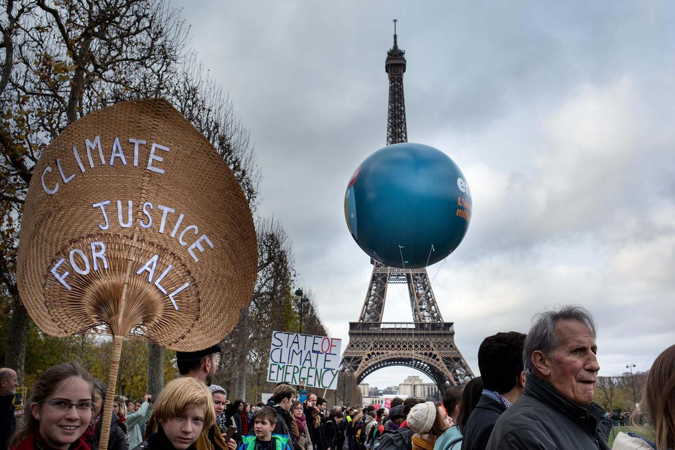
Are we, the People, on track to meet the Paris Agreement by 2030?
Data for Climate Justice

Slide 3
Overview
Introductions and Project Rationale: Climate Justice (All)
Paris Agreement Background (Angela)
History of Global CO₂ Emissions (Jeremy)
Global CO₂ Emission Summary (Jeremy)
History of US CO₂ Emissions (Angela)
History of US Energy Expenditure (George)
2030 Projections for US CO₂ Emissions (George)
2030 Projections for US Energy Expenditure (George)
What Can We Do?

Slide 4
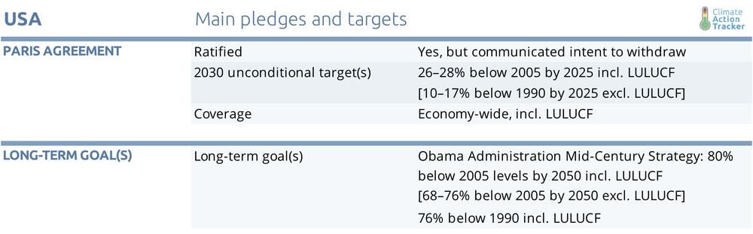
Paris Agreement & US Goal
Notes:
Angela:
On 12 December 2015, Parties to the UNFCCC reached a landmark agreement to combat climate change and to accelerate and intensify the actions and investments needed for a sustainable low carbon future.
The Paris Agreement’s central aim is to strengthen the global response to the threat of climate change by keeping a global temperature rise this century well below 2 degrees Celsius above pre-industrial levels and to pursue efforts to limit the temperature increase even further to 1.5 degrees Celsius.
The Paris Agreement requires all Parties to put forward their best efforts through “nationally determined contributions”

Slide 5
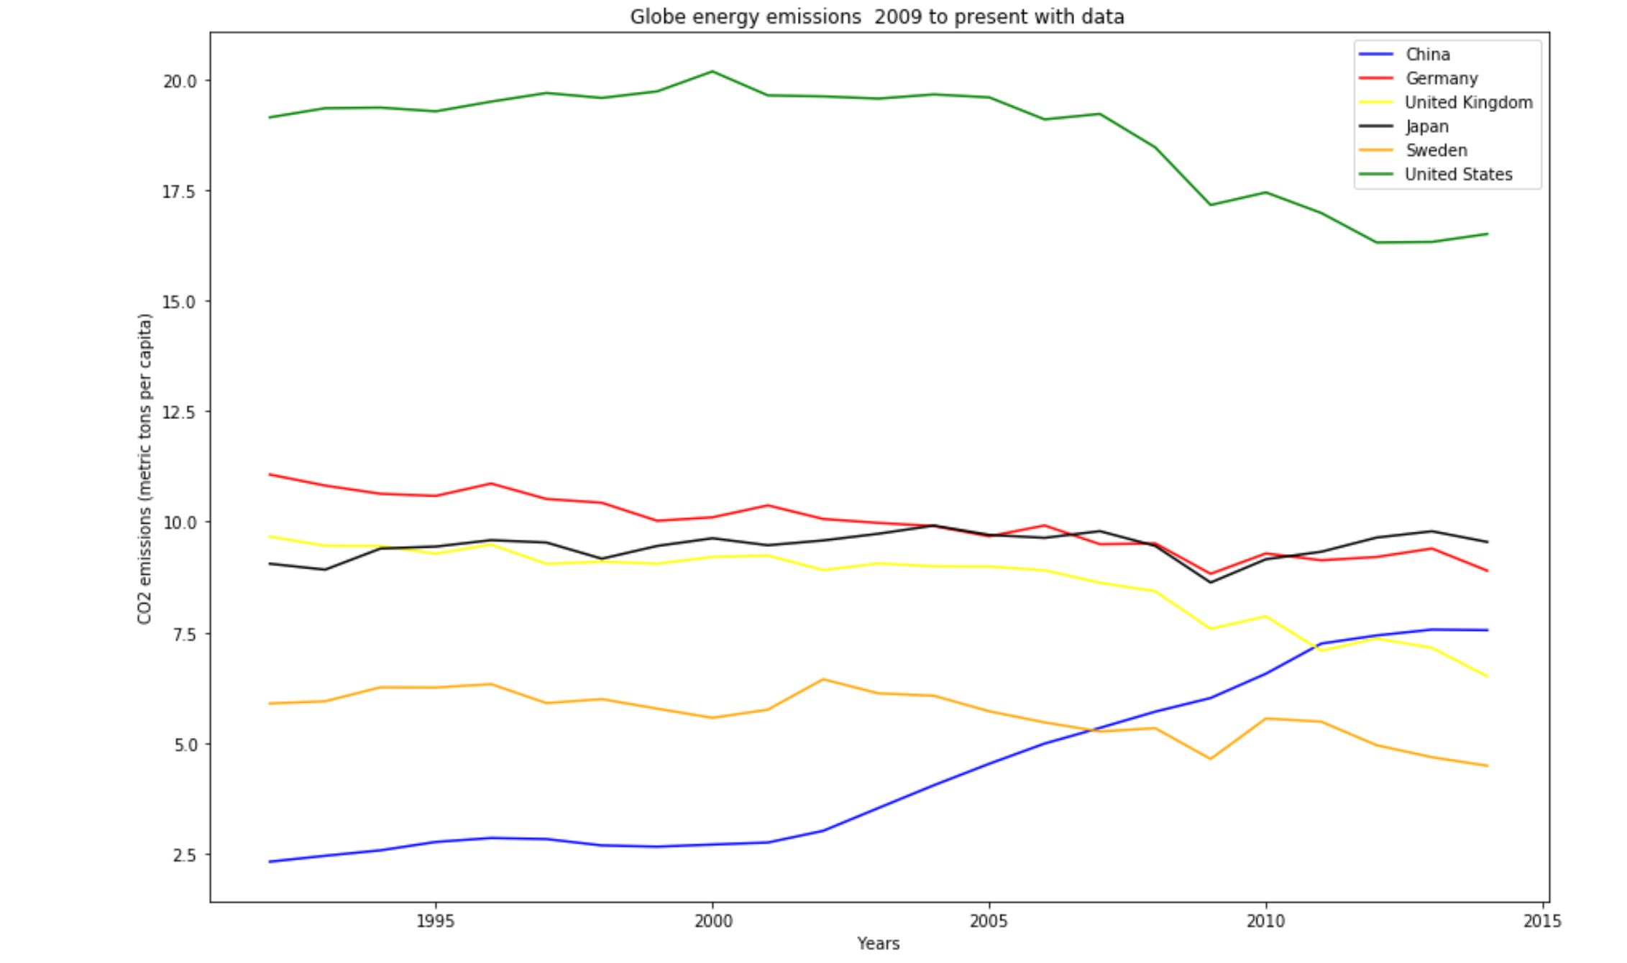
History of Global CO₂ Emissions (1990 - 2015)
Notes:
Jeremy: Rolling Mean (12) to smooth out the data

Slide 6
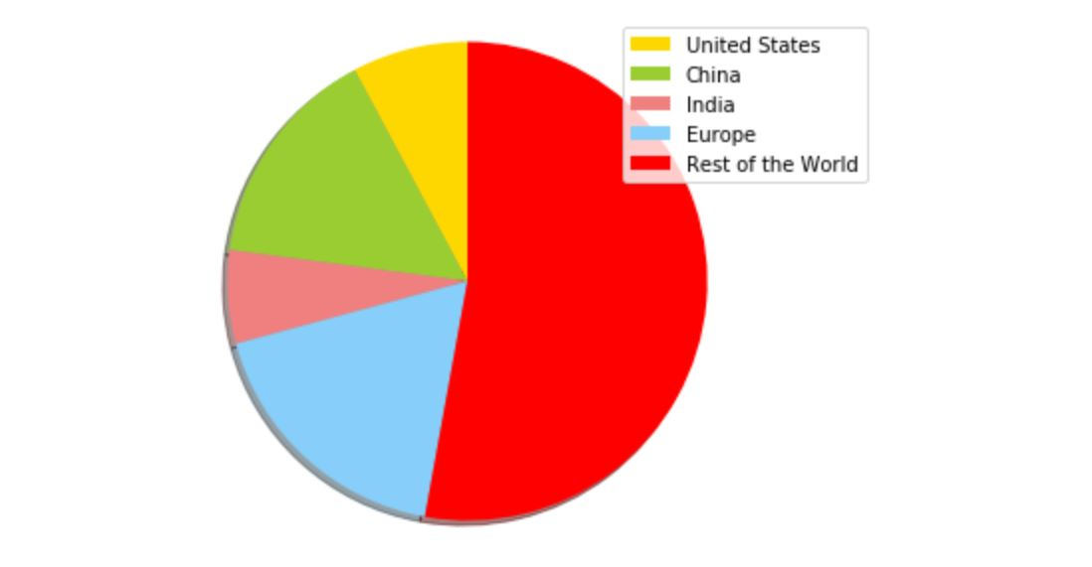
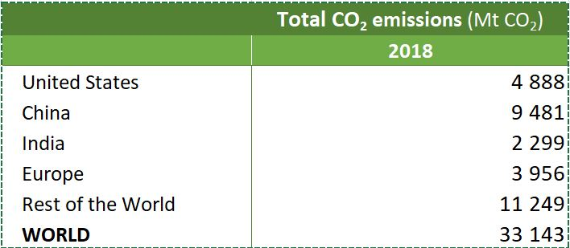
Global CO₂ Emissions
Notes:
Jeremy: Rolling Mean (12) to smooth out the data

Slide 7
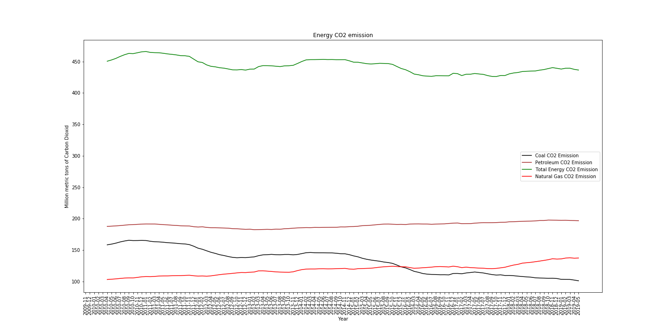
History of US CO₂ Emissions (noise-reduced)
(by Energy Source)
Notes:
AngelaRolling Mean (12) to smooth out the data

Slide 8
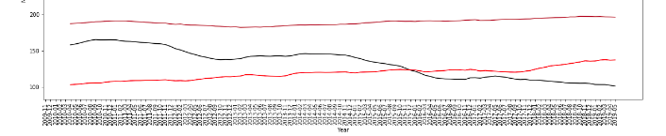
Cleaning Up the Data - Running into Dating Problems
Notes:
AngelaRolling Mean (12) to smooth out the data

Slide 9
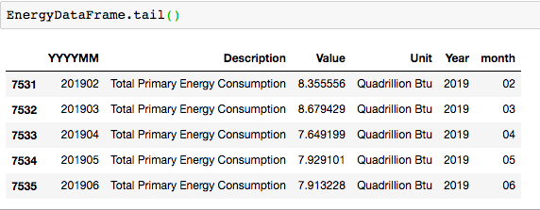
Cleaning Up the Data - Date Formatting
Notes:
AngelaRolling Mean (12) to smooth out the data

Slide 10
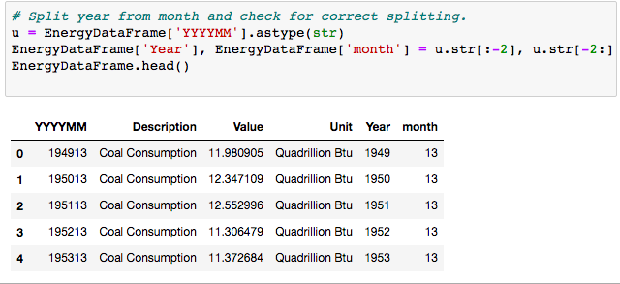
Cleaning Up the Data - Date Formatting - Splitting the Date
Notes:
AngelaRolling Mean (12) to smooth out the data

Slide 11
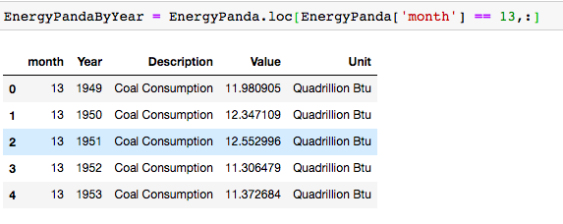
Cleaning Up the Data - Getting Annual Data using Loc
Notes:
AngelaRolling Mean (12) to smooth out the data

Slide 12
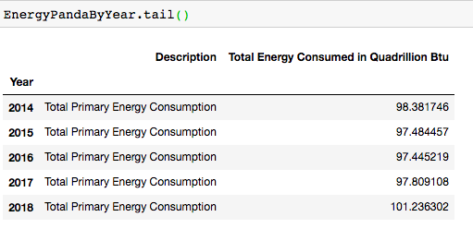
Cleaning Up the Data - Using Loc to Isolate Yearly Data
Notes:
AngelaRolling Mean (12) to smooth out the data

Slide 13
2030 Projections for US Energy Consumption
Coal down in 22% generation in 2030
Gas usage with 38%
Renewable with 24%
Nuclear makes up the rest
** All Data are based on Projected with 2018 National Data **

Slide 14
What Can We Do?
If We, the People, continue with our current trend of energy consumption and CO₂ emissions, where will be in 2030?
100% renewable energy is needed
Decrease carbon footprint by using carpool or public transportation
Think about environmental impact before making any purchase
Government/policy makers need to pay attention to climate issues, and promote incentive programs for green energy.

Slide 15
Source
https://climateactiontracker.org/
https://www.iea.org/statistics/?country=JAPAN&year=2016&category=Emissions&indicator=TotCO2&mode=chart&dataTable=INDICATORS
https://ec.europa.eu/eurostat/statistics-explained/index.php/Greenhouse_gas_emission_statistics
https://www.eia.gov/outlooks/ieo/

